Slide 1
Lockstep
Study and implementation of a network library for
distributed deterministic simulations
Raffaele Zippo, Enrico Meloni

Slide 2
Inputs for the simulation are generated by clients
Each client computes the new state of the simulation by applying inputs
All the clients need a coherent view of the state
Case study: Multiplayer RTS
Notes:
Starcraft example: hundreds of units on the field, huge battles, small divergences can lead to very different results

Slide 3
The FrameQueue
Time is divided in chunks called frames. Each input is assigned to a frame
All clients execute the same input during the same frame
By scheduling new inputs for a later frame, we can introduce enough delay to propagate it to all clients and keep executing without interruptions
The delay introduced should be dimensioned for the application requirements and network characteristics

Slide 4
Network architecture
Client-Server architecture
Each clients sends its inputs to the server
The server forwards to each client others’ inputs
Better performance and scalability
Assuming better client-server connection
P2P would easily saturate client’s upload and increase delays
Server
Client 1
Client 2
Client 3
Client 4

Slide 5
Network protocol
Custom protocol based on UDP
Reliability
Minimum delay
LockstepCommand: interface implementing Serializable
Implemented by the application command
Using Java serialization leads to high bandwidth usage
Minor solution by adding GZIP compression of outgoing packets

Slide 6
Software demonstration

Slide 7
Client Structure
Notes:
LockstepClient blocks on the queues waiting for the next inputs to be available

Slide 8
Server structure
Notes:
The server does not generally blocks, unless there are no inputs available to forward

Slide 9
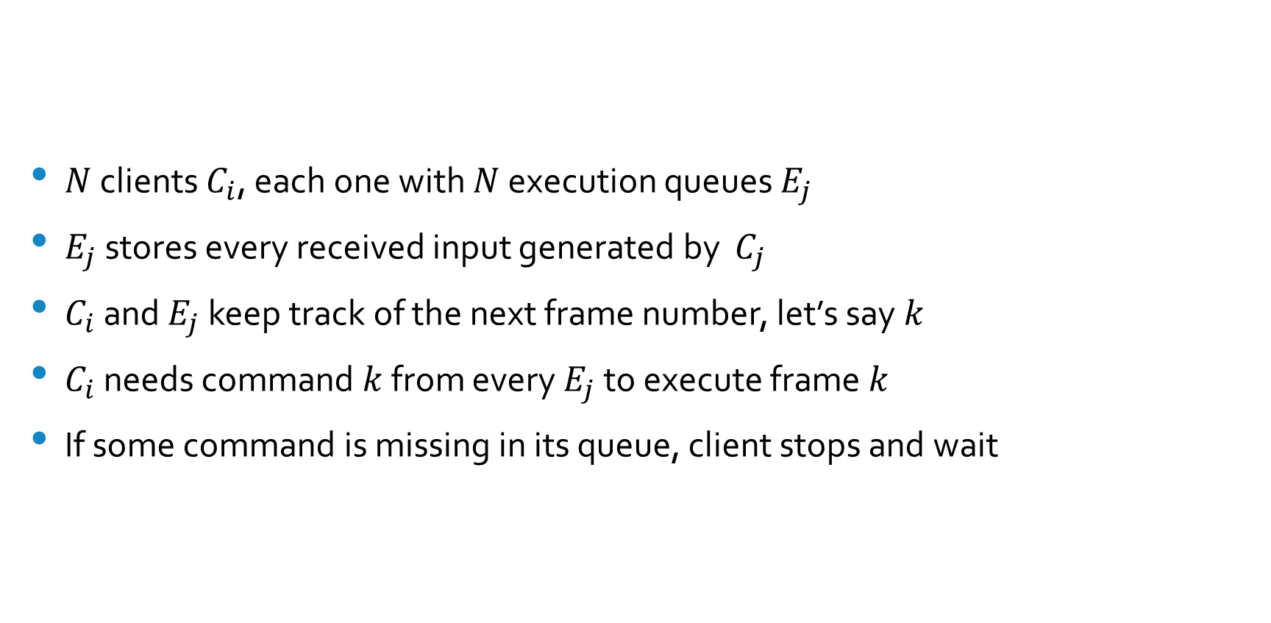
Client-side Synchronization (1)
$N$ clients $C_{i}$, each one with $N$ execution queues $E_{j}$
$E_{j}$ stores every received input generated by $C_{j}$
$C_{i}$ and $E_{j}$ keep track of the next frame number, let’s say $k$
$C_{i}$ needs command $k$ from every $E_{j}$ to execute frame $k$
If some command is missing in its queue, client stops and wait

Slide 10
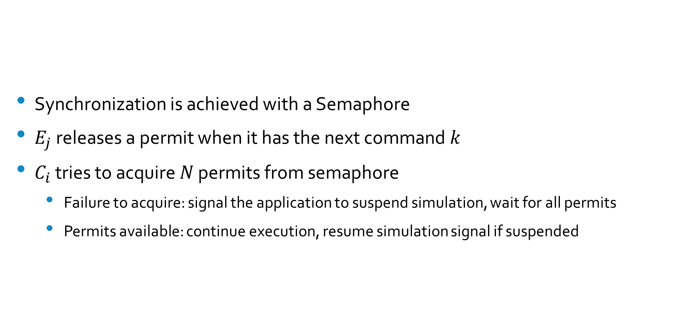
Client-side Synchronization (2)
Synchronization is achieved with a Semaphore
$E_{j}$ releases a permit when it has the next command $k$
$C_{i}$ tries to acquire $N$ permits from semaphore
Failure to acquire: signal the application to suspend simulation, wait for all permits
Permits available: continue execution, resume simulation signal if suspended

Slide 11
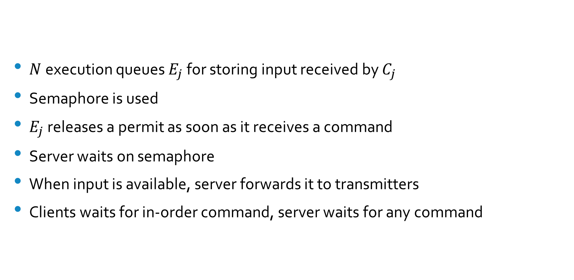
Server-side Synchronization
$N$execution queues $E_{j}$ for storing input received by $C_{j}$
Semaphore is used
$E_{j}$ releases a permit as soon as it receives a command
Server waits on semaphore
When input is available, server forwards it to transmitters
Clients waits for in-order command, server waits for any command

Slide 12
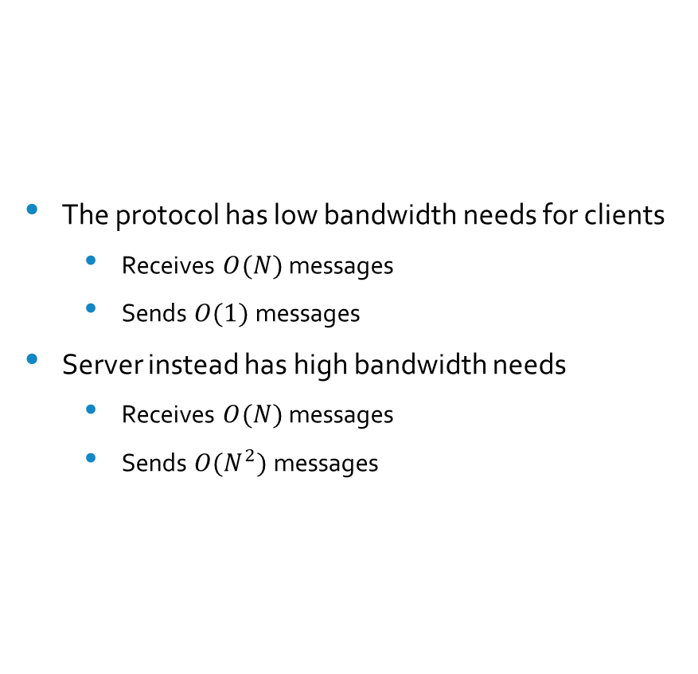
Scalability
The protocol has low bandwidth needs for clients
Receives $O(N)$ messages
Sends $O(1)$ messages
Server instead has high bandwidth needs
Receives $O(N)$ messages
Sends $O(N^{2})$messages

Slide 13
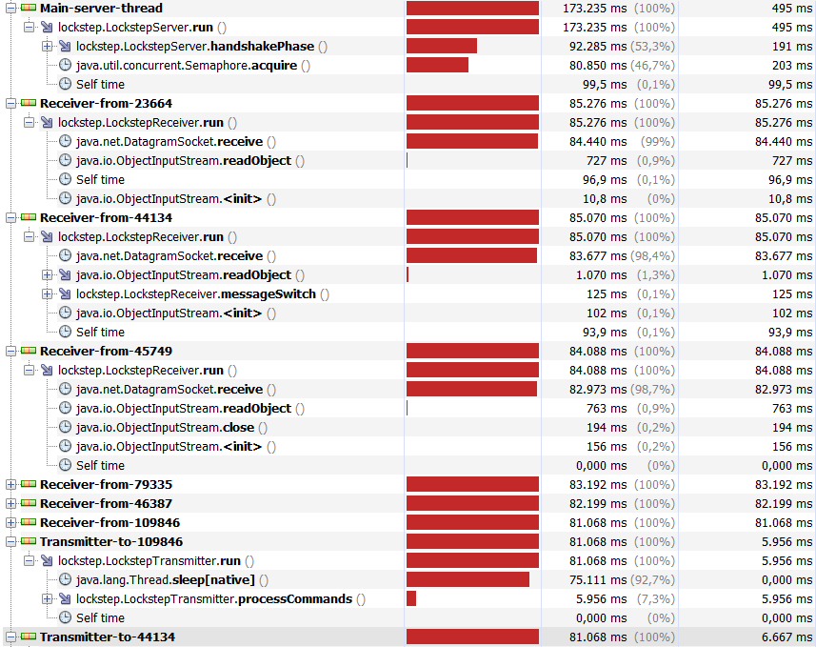
Future developments
Receivers and transmitters are mostly idle
Use idle time to improve serialization
Key objective: reducing bandwidth
Optional P2P architecture
For high-bandwidth clients (LAN)
Adaptive input-to-execution delay
Security
Authentication
Integrity
State validation (anti-cheat)

